Slide 1
Credit Card Fraud Detection
Vineet Alexander Kujur

Slide 2
Problem Statement
To detect fraudulent transactions at Finex
Reduce losses incurred due to unauthorised transactions by the fraudsters.

Slide 3
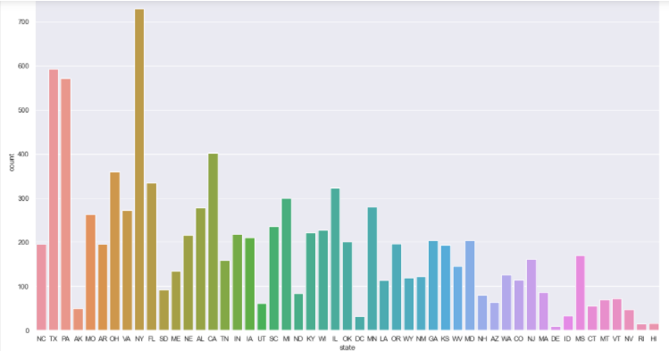
Business insights
Most of the fraudulent transactions are from the state of New York followed by Texas.

Slide 4
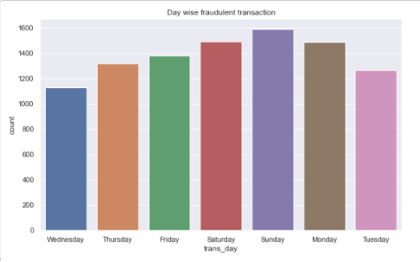
Most of the fraudulent transactions are done on Sundays and Saturdays.

Slide 5
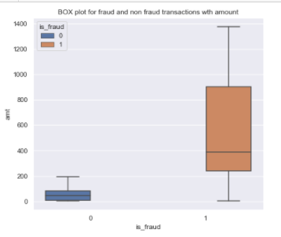
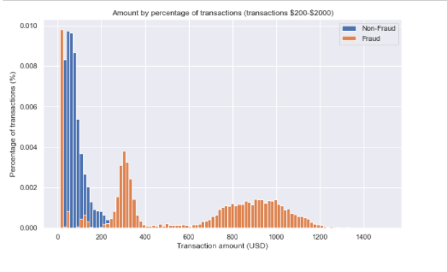
Fraudulent transactions have high $ values but most of the transactions are between $200-$400.
Highest density of transactions are between $200 to $ 400.

Slide 6
Cost benefit analysis
Cost incured before model deployment
Average Transactions per month —> 154,366.16
Average number of fraudulent transaction per month —> 804.25
Average amount per fraud transaction —> $ 530.66
Cost incurred per month before the model deployment - $ 426,783.31

Slide 7
COST incurred after model deployment
Average number of transactions per month detected as fraudulent by the model (TF) – 164
Cost of providing customer executive support per fraudulent transaction detected by the model - $ 1.50
Total cost of providing customer support per month for fraudulent transactions detected by the model - $ 246.13
Average number of transactions per month that are fraudulent but not detected by the model – 77.17
Cost incurred due to fraudulent transactions left undetected by the model - $ 40,949.26
Cost incurred per month after the model is built and deployed - $ 41,195.39

Slide 8
Final savings
Final savings = Cost incurred/month (before model deployment) –Cost incurred/month (after model deployment)
$ 385,587.92
Annual Savings = $ 4,627,055

Slide 9
Additional Insights
Model Used → Random Forest on Smote data
Aimed at detecting most of the fraud cases (recall), whilst keeping the cost at which this is achieved under control (precision).
Accuracy: 0.9943730554470874
ROC AUC : 0.838078396814827
Precision : 0.47218225419664267
Recall : 0.6801381692573403
Top 3 features are Amount, age and trans_January(highest no of transaction month ) able to explain the variation and can be used to detect fraud.

